Slide 1
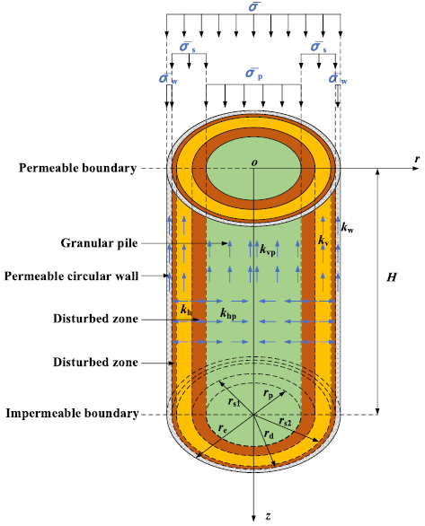
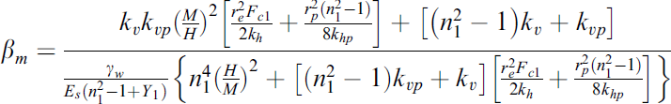
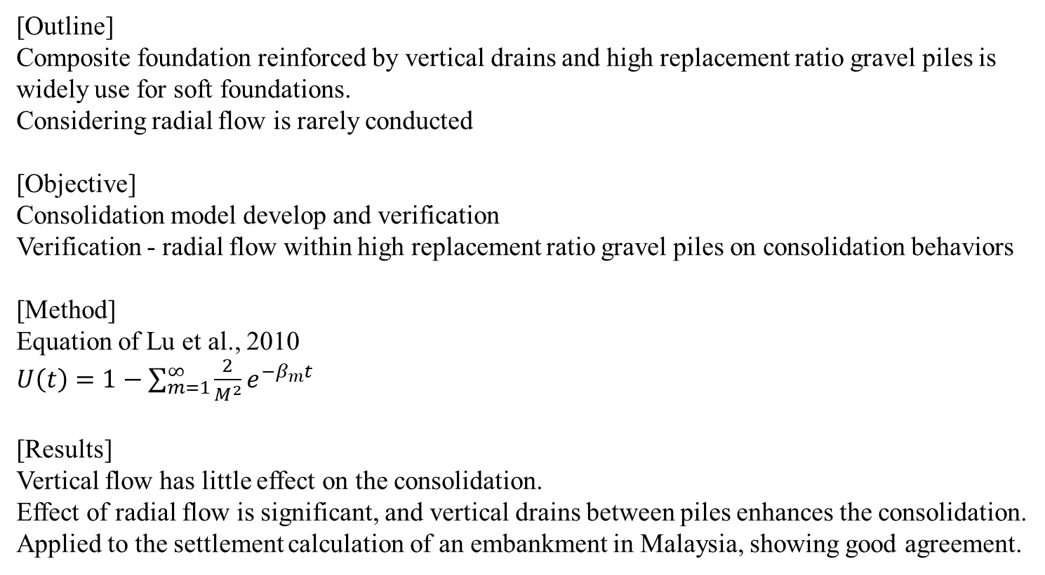
Soils and Foundations 63 (2023) 101393 https://doi.org/10.1016/j.sandf.2023.101393
An analytical solution for the consolidation of a composite foundation reinforced by vertical drains and high replacement ratio gravel piles by considering the radial flow within gravel piles Chuanxun Li, Xiangzong Lu, Peng Wang
[Outline]
Composite foundation reinforced by vertical drains and high replacement ratio gravel piles is widely use for soft foundations.
Considering radial flow is rarely conducted
[Objective]
Consolidation model develop and verification
Verification - radial flow within high replacement ratio gravel piles on consolidation behaviors
[Method]
Equation of Lu et al., 2010
$U\left(t\right)=1−\sum_{m=1}^{∞}{\frac{2}{M^{2}}e^{−β_{m}t}}$
[Results]
Vertical flow has little effect on the consolidation.
Effect of radial flow is significant, and vertical drains between piles enhances the consolidation.
Applied to the settlement calculation of an embankment in Malaysia, showing good agreement.

Slide 2
Soils and Foundations 63 (2023) 101401 https://doi.org/10.1016/j.sandf.2023.101401
Axial capacity ageing trends of large diameter tubular piles driven in sand D. Cathie, R. Jardine, R. Silvano, S. Kontoe, F. Schroeder
[Background]
Target object – Driven open-ended tubular piles in sandy ground.
Target problem – axial capacity change according to the time (≈25-day - ICP-050 / ≈14-day – Unified databases)
[Methods]
Project of PAGE JIP
Data use from 25 cases of end-of-initial driving (EoID) and beginning-of-restrike (BoR) instrumented dynamic monitoring.
Static resistances derived from signal matching by 2 independent teams using different software are compared with CPT-based pile capacity calculations.
[Results]
- Most capacity change – first 2-10 days after installation. (attributed to density and the interactions at the pile-sand interface)
- Between 20-30 days,
No change of large diameter piles ↔ small diameter piles still capacity change.
Due to the diameter-dependent constrained dilatancy, larger diameter piles are more stable.
- CPT-based calculation is good. But significant discrepancies between predicted and actual capacities, especially for large diameter piles, suggest that adjustments in design methods may be necessary.
- Improvements in Design Methods: The results highlight the need for improvements in CPT-based design methods. Particularly for large diameter piles, additional factors must be considered in the design, indicating the need for further research and data to enhance the accuracy of design standards.
[Comment] This paper provides important guidelines but that is all.

Slide 3
Soils and Foundations 64 (2024) 101421 https://doi.org/10.1016/j.sandf.2023.101421
Unconditional convergence of theoretical solutions to u-p formulation Tomohiro Toyoda, Toshihiro Noda
solutions to the u-p formulation exhibit convergence regardless of k.
[Background]
Dynamic soil-water coupling analyses, based on u-p formulation, are inapplicable to high k soils, cause numerical instability.
It assumes that the relative acceleration of pore water compared to the soil skeleton is negligibly small.
This is not the problem of equation. This is the numerical problem
[Governing equations and theoretical solutions under one-dimensional condition]
The document also describes how the u-p formulation underestimates permeability, overestimates compression wave celerity, and results in negative excess pore water pressures under positive loading conditions.
u-p formulation underestimate k, overestimate compression wave celerity, and results in -EPWP under positive loading conditions.
[Characteristics of Theoretical Solutions for the u-p Formulation]
The theoretical solutions for u-p are expressed as the superposition of eigenmodes. Each mode shows either exponential or trigonometric solutions depending on the dimensionless coefficient h#. Notably, in cases of high permeability, non-harmonic waves propagate.
[Conclusion]
This research highlights that the numerical instability seen in the u-p formulation does not appear in its theoretical solutions, affirming the feasibility of using the u-p approach by demonstrating its unconditional convergence in theoretical models.

Slide 4
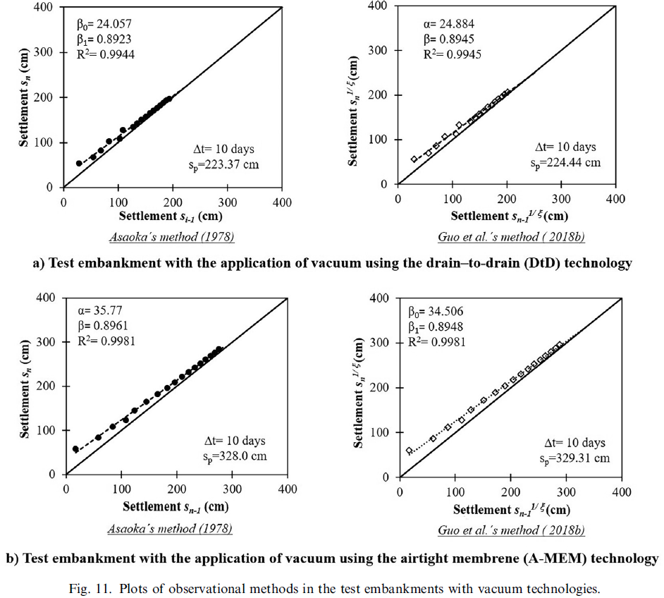
Soils and Foundations 64 (2024) 101410 https://doi.org/10.1016/j.sandf.2023.101410
Vacuum consolidation effect on the hydromechanical properties of the unusual soft clays of the former Texcoco Lake
Norma Patricia Lopez-Acosta, Alejandra Liliana Espinosa-Santiago
[Outline]
Texcoco Lake in Mexico is soft lacustrine clay strata with high water content and high compressibility.
New airport construction requires soil stabilization.
Method is use of vacuum preloading systems that apply a vacuum to the soil through vertical drains.
[Method]
This study evaluates improvement on hydromechanical properties resulting from implementation of 2 vacuum techniques.
1. embankments with surcharge preloading and vertical drains to apply a vacuum using the drain-to-drain technique
2. airtight membrane technique.
The average vacuum pressures -58 kPa and -63 kPa with the drain-to-drain and airtight membrane techniques, respectively.
[Results]
airtight membrane - w 50 %, e 46 %, s 86 %
drain-to-drain - w 15 %, e 13 %, s 88 %

Slide 5
Soils and Foundations 64 (2024) 101402 https://doi.org/10.1016/j.sandf.2023.101402
Variability in jacking resistance of adjacent steel pipe piles under controlled pile installation Naoki Suzuki, Kohei Nagai
[Background]
The pile bearing capacity varies even within the same site.
[Method]
* Understanding of the effect of pile penetration techniques on the variability of bearing capacity.
* Uses data from 83 jack-in test piles to explore the variations in penetration resistance at the pile head, base, and shaft.
* Organize theory of the uncertainty in the pile bearing capacity, following geostatistics (focus on the difference in the penetration resistance of piles within 5 m, considering it as the piling error).
* Methodology of the tests with small-diameter steel pipe piles using different types of jacking methods, and penetration resistance was measured during pressing, loading, and extracting.
* Load tests to confirm that the jacking resistance is approximately equal to the ultimate bearing capacity at the load tests, judging that it was reasonable to use the jacking resistance to analyze the piling error.
* Penetration and the extraction tests through analyzing extracted resistance force.
[Results]
Errors follow a lognormal probability distribution, and the COV in penetration resistance at the heads and bases is about 10%, while the COV in extracted resistance varies widely, with a range of 5–25%.
Little difference in the variations due to piling workmanship was observed among different penetration motions, speeds, and soil types.
[Comment]
Too many information in one research paper.
I can’t understand the best range of the information in one paper.

